Slide 1
FCC3 246: CONCRETE MATERIALS
Lecture 11: PROPERTIES OF AND TESTS ON - HARD CONCRETE
Department of Civil & Construction Engineering
University of Nairobi
mwauras@uonbi.ac.ke

Slide 2
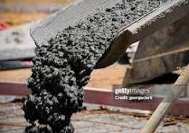
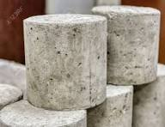
Properties of Plain Concrete
Properties of concrete may be those in plastic (fresh, wet or green) stage, and also in the hardened state

Slide 3
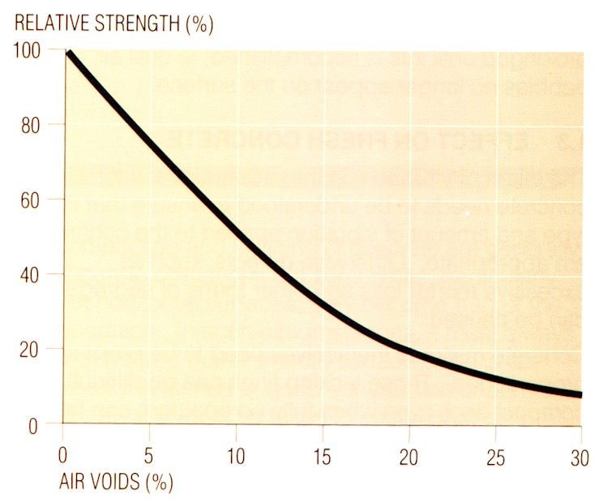
Compaction
Entrapped air in the concrete
  1% air reduces concrete strength by 5% to 6%
  It increases permeability
  Reduces bond to steel
  Voids are aesthetically displeasing
Protect steel reinforcement
Off shutter finish

Slide 4
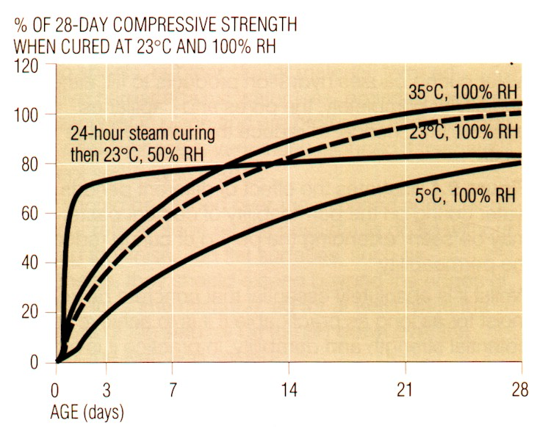
Curing
Description
  Promotion of hydration
    Control moisture
    Control temperature
  Need 80% humidity in pores for hydration

Slide 5

Hardening of Concrete
Unlike mud which becomes hard as a consequence of drying, concrete sets and gains strength because of a chemical reaction between grains of cement and water. This chemical reaction is called hydration and is exothermic.
Hydration (and its associated strength gain) will stop if the concrete
dries out. Freshly placed concrete must therefore be kept wet (cured).

Slide 6
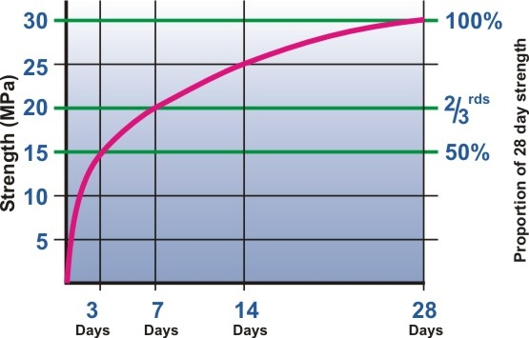
The hardening and strengthening process
This graph illustrates the typical rate at which normal portland cement concrete gains strength at an ambient temperature of about 20⁰C. Alteration of the type of cement and temperature would change the exact shape of the curve. The curve is an inverse log function.

Slide 7
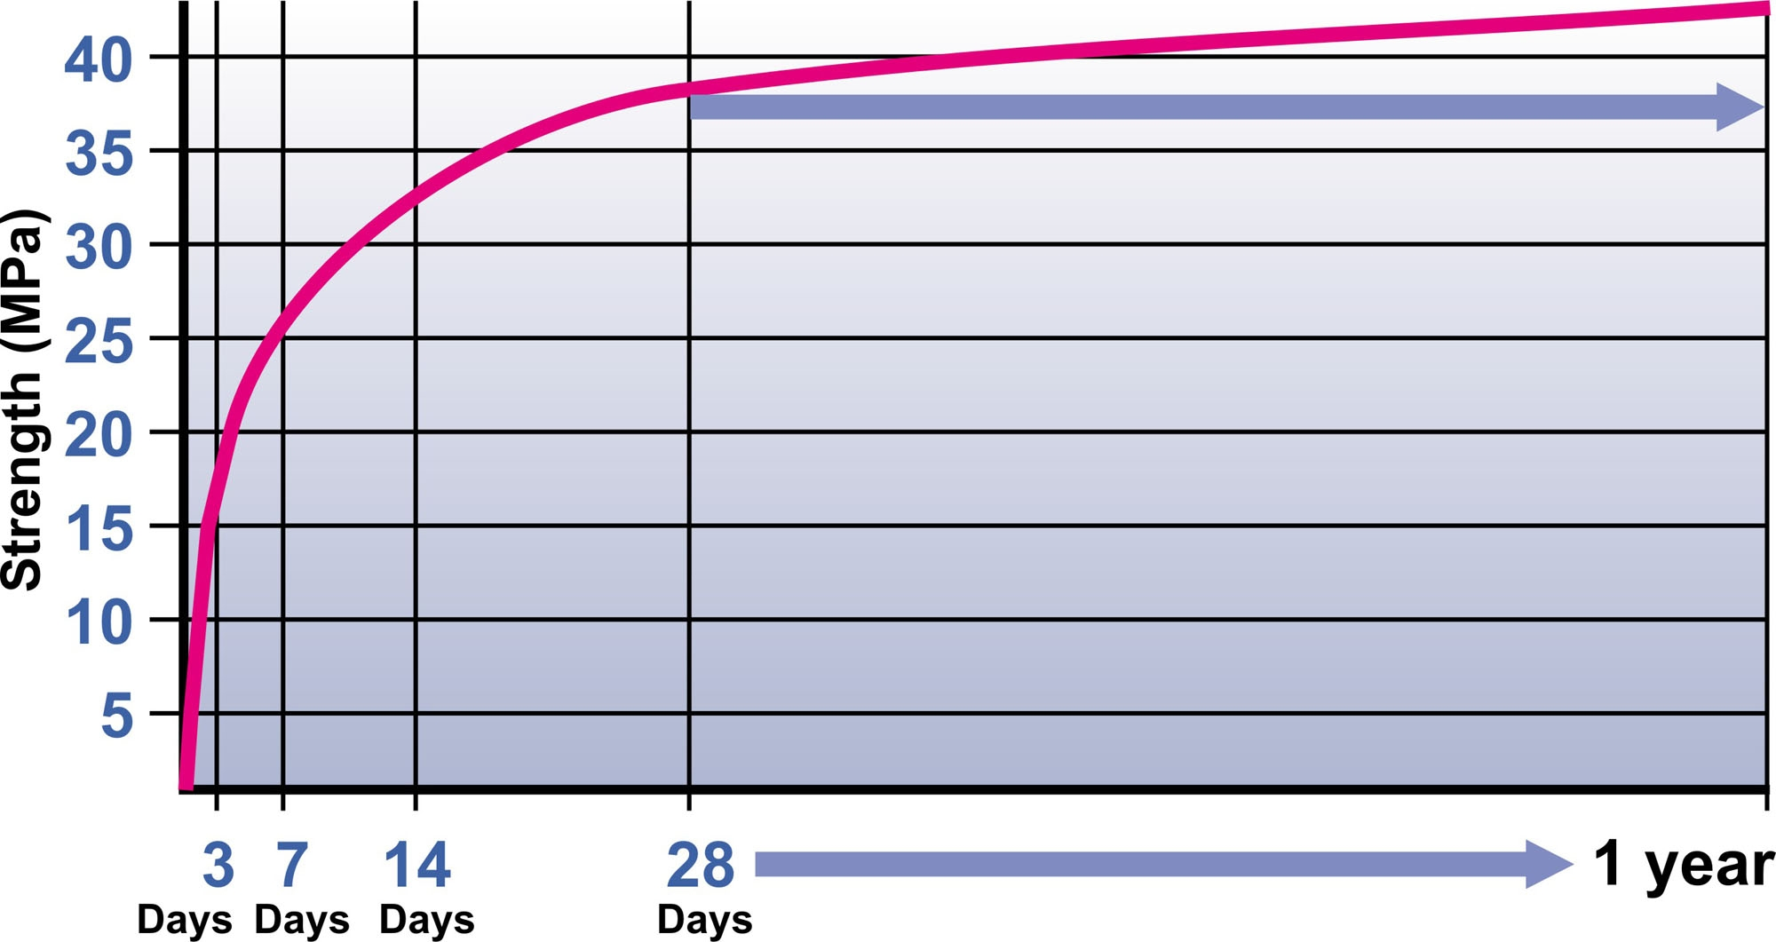
When does concrete reach its full strength?
For convenience, engineers often specify concrete strength at 28 days. This should not be taken to imply that at 28 days the concrete stops gaining strength. As long as there is both un-hydrated cement and water present, concrete has the potential to gain strength. If fact, measurable strength gains have been recorded after six years and in theory, concrete made in Roman times is becoming stronger day by day. In large dams, it is not uncommon for engineers to specify strengths at 56 or 90 days.

Slide 8
Hardening Process
Hydration reaction commences. Cementing reactions change concrete from plastic to semi solid
6 - 12 hours after mixing - Weak solid
Temperature rises
Expansion takes place
Cooling, contraction & internal cracking
Strong enough to support workers
Surface can still be trowelled or brushed
Protect from damage

Slide 9
Factors Affecting Temperature Rise
Cement type & content
Concrete temperature when mixed
Mix proportions
Aggregate type
Concrete thickness & formwork type
Ambient Temperature, wind & relative humidity

Slide 10
Properties of Hardened Concrete
Strength – Compressive; Tensile; Bond Strengths
Impermeability
Abrasion - Resistance to Wear, Weather and Chemical Attacks
Shrinkage
Creep
Durability
Dimensional stability
Density
Fire Resistance

Slide 11
Factors influencing properties of Hardened Concrete
Water-Cement ratio
Constituent material
Cement type and content
Water content
Compaction and air content
Curing
Temperature

Slide 12


Temperature
  Higher temperature causes faster hydration
  Lower temp at casting may eventually give higher strengths
  In summer concrete achieves higher early strengths
  Low ambient temperatures will result in slower strength growth

Slide 13
i. Strength
Strength is a generic term for the ability of a material to resist strain or rupture induced by external forces.
Strength / Stress = Load ÷ Area
Pascal = 1N/m² = 1 N ÷ 1 m²
1 000 Pa = 1 kPa
1 MPa = 1 000 000 Pa
1MPa=1 000 000Pa = 1 000 000 N ÷ 1 m²
1 000 000 N/m² = 1 000 000 N / 1 000 000 mm² = 1 N/mm²
Therefore 1MPa = 1N/mm²
This means class 20 concrete = 20N/mm² = 20MPa

Slide 14
Typical Strengths at 28 days
Mass filling - 10 MPa
Foundations for houses - 15 MPa
Floors and surface beds - 20 MPa
Home driveways reinforced - 25 MPa
Factory floors, farm roads - 30 MPa
Precast concrete - 35 MPa

Slide 15
Concrete strengths
Low strength (15 MPa)
  Suitable for unreinforced foundations (single storey, mass fill, infill in masonry
Medium strength (25 MPa)
  Suitable for unreinforced slabs, reinforced slabs and foundations, footpaths and domestic driveways
High strength (30 MPa)
  Suitable for reinforced concrete members, heavy duty floors and precast items like flagstones.

Slide 16
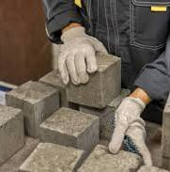
i. Strength – Compressive, Tensile and Bond Strengths
  Good concrete has good strength in compression compared to most building materials. Tensile strengths and bond strengths of concrete are generally 10% of the compressive strength of concrete. In compression, concrete has a wide range of strengths and stress-strain relation.
  Stress, (σ) = Force / Area (N/mm²)
  Strain, (ε) = Change in dimensions / Original dimensions (Dimensionless / Ratio)
  Modulus of Elasticity, (E_{c}) = Stress / Strain (N/mm²)

Slide 17
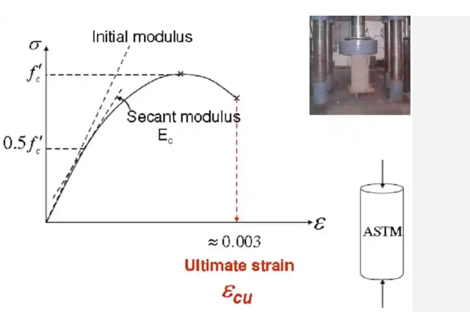
i. Strength – Stress-Strain Curve for Concrete in Compression
  As the load is applied, the ratio between the stresses and strains is approximately linear at first and the concrete almost behaves as an elastic material with virtually full recovery of displacement if the load is removed. Eventually, the curve is no longer linear and the concrete behaves more and more as a plastic material. If the load were removed during the plastic stage, the recovery would no longer be complete and a permanent deformation would remain. The ultimate strain for most structural concretes tends to be a constant value of approximately 0.0035, irrespective of the strength of the concrete. The modulus of elasticity, (E_{c}) of concrete may be defined as the ratio of stress to corresponding strain in concrete. It is a measure of the stiffness of the concrete structure and its values varies from 1.4 to 3.0 kN/mm².

Slide 18
Accelerated Strength Testing
To allow early predictions
Changes in concrete properties may be detected early
Corrective action can be taken to improve quality
Cost of investigation, assessment and remedial work can be minimized
Minimize delays
Can replace 28-day testing.

Slide 19
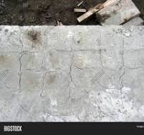
iv. Shrinkage
  As concrete hardens, there is reduction in volume. This is called shrinkage, and is liable to cause cracking of the concrete. Shrinkage begins to take place as soon as the concrete is mixed, and is caused initially by the absorption of the water by the cement and the aggregates. Further shrinkage is caused by evaporation of the water which rises to the concrete surface. During the setting process, the hydration of the cement causes a great deal of heat to be generated, and as the concrete cools, further shrinkage occurs due to thermal contraction.

Slide 20
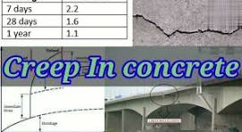
v. Creep
  Continued sustained loads applied to concrete cause long-term permanent deformation which is called creep. It can also be defined as the gradual increase in strain with time in a member subjected to prolonged stress. Creep does not disappear completely on the removal of sustained load. Creep is desirable in in concrete structures as it causes better distribution of stresses. Creep causing excessive deformation and deflection is undesirable.

Slide 21
viii. Density
Depends on: density of aggregates, cement content and water content

Slide 22
viii. Density
Density is the mass of a material per unit volume
Density of water is 1000 kg/m³
Relative density is the density of a material relative to the density of water
Material | Relative Density
Cement | 3.14
Natural Aggregate | 2.5 – 3.0
Fly ash | 2.3
GGBS | 2.9

Slide 23
viii. Density
One cubic metre of typical structural concrete contains approximately 2400 kg of materials. Therefore the density of most concrete is between 2300 kg/m³ and 2500 kg/m³ whilst the density of water is only 1000 kg/m³
Precise density depends on the weight of the aggregate, cement content and the water content

Slide 24
TESTS ON HARD CONCRETE

Slide 25
TESTS
Cubes according to BS EN 12390
Cylinder tests to BS EN 12390
Non-Destructive Tests (In-Situ Hardened Concrete) – BS 1881 and BS 6089

Slide 26
RELEVANT CODES
BS EN 206 Concrete - This standard specifies requirements for: constituent materials of concrete, properties of fresh and hardened concrete and their verification, limitations for concrete composition, specification of concrete, delivery of fresh concrete, production control procedures, conformity criteria and evaluation of conformity.
BS EN 12390 for testing hardened concrete e.g. cube testing and and Concrete tests: Part 1: Consistence of freshly mixed concrete
BS 1881 for various (hardened) concrete testing methods

Slide 27
TESTS ON HARD CONCRETE - CUBE TEST

Slide 28
The Cube Test - Making Cubes
Sample mix
Assemble moulds, release agents
Fill moulds (2 or 3 layers)
Fully compact each layer
Level off
Label
Protect against drying out
Remove from moulds after 16 to 28 hours

Slide 29
The Cube Test - Curing
Stored under water until time of test
Water level must always cover tops of specimens
Maintain 25mm space around each specimen
Permissible to stack on top of each other
Constant temperature in curing tanks 20°C ± 2°C
Water to be kept clean and circulated.

Slide 30
Accelerated Curing
Test cubes are cast as normal
Cover plate is fitted to top of mould to isolate concrete from water in curing tank
Cubes are placed in curing tank immediately after casting
Immersed in water in insulated curing tank
Three alternative methods based on different curing regimes: 35°C, 55°C and 82°C
Cubes tested just after demoulded.

Slide 31
Cube testing (BS EN 12390-2)
Cube testing is done for control and compressive strength prediction
Common faults
  Placing cubes off-centre
  Shape and size of cube not accurate
  Faults in testing machine
Moulds must be square, inner faces plane, parallel and hard
100mm moulds used for conc with stone ≤ 20mm
150mm moulds used for conc with stone ≥ 20mm

Slide 32
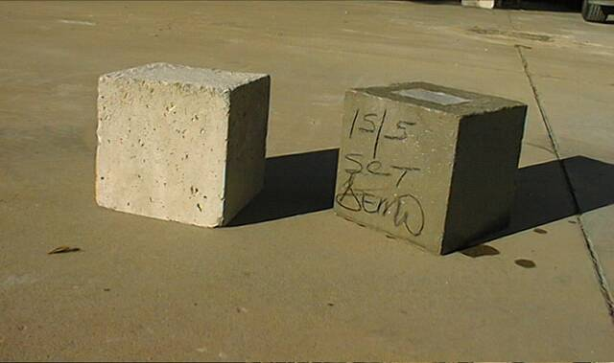
Moisture Condition at Time of Test
Strength testing on concrete is always done on saturated samples as this is the weakest state
Oven-dry cubes could be up to 35% stronger than equivalent saturated cubes

Slide 33
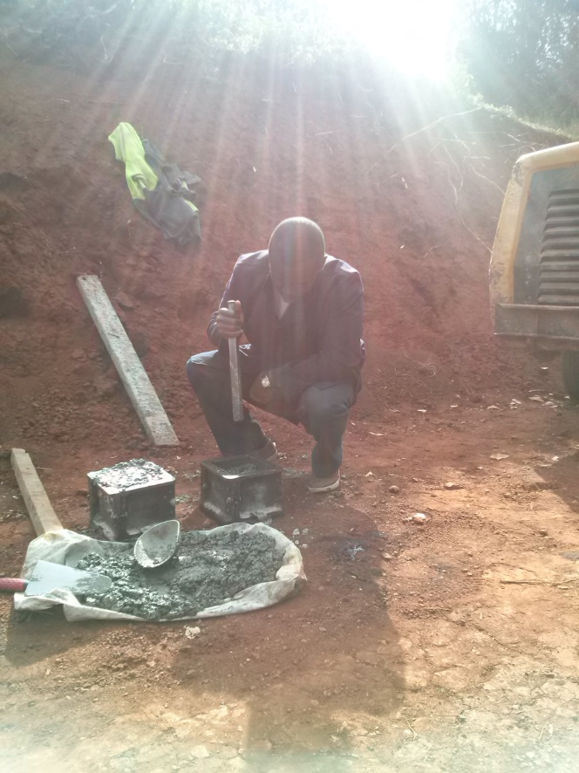

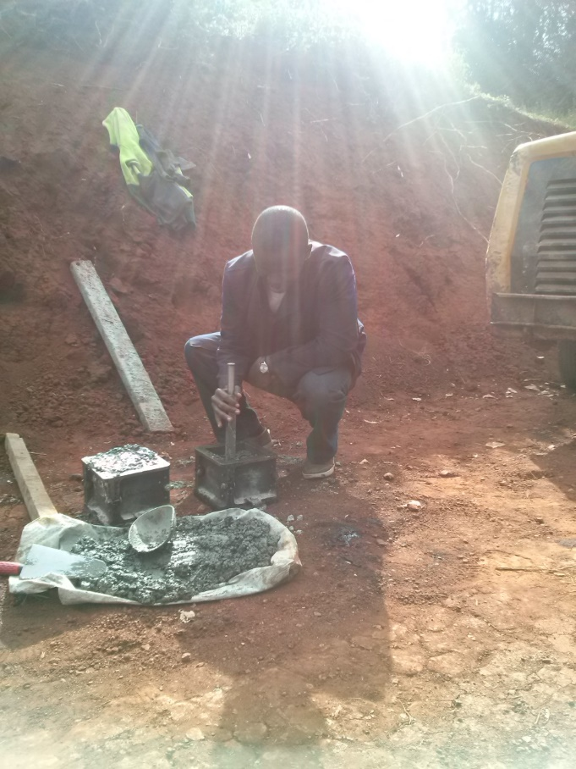

Cube Tests of Hardened Concrete

Slide 34
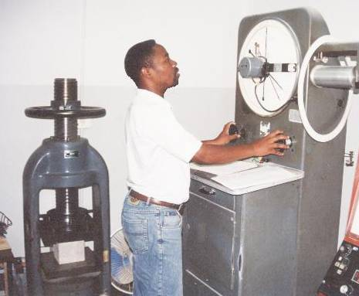
Crushing of Cubes

Slide 35
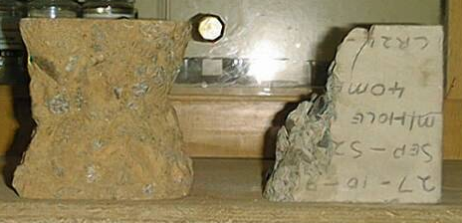
The Cube Test - Testing Cubes
Remove from tanks
Wipe off excess water
Place in machine correctly!
Load at a stress rate of 0,6 ± 0,2 MPa/s
Record maximum load in kN
Strength in MPa = (load over area)
Record strength to nearest 0.5 N/mm²
Observe the failure mode

Slide 36
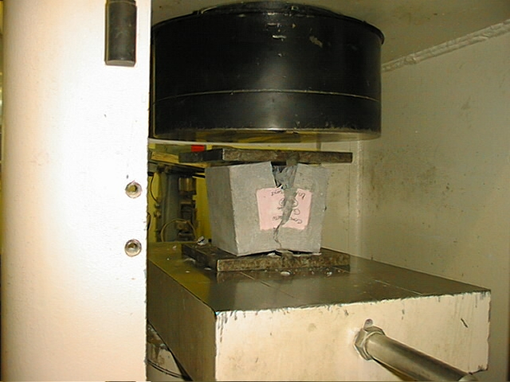

Slide 37
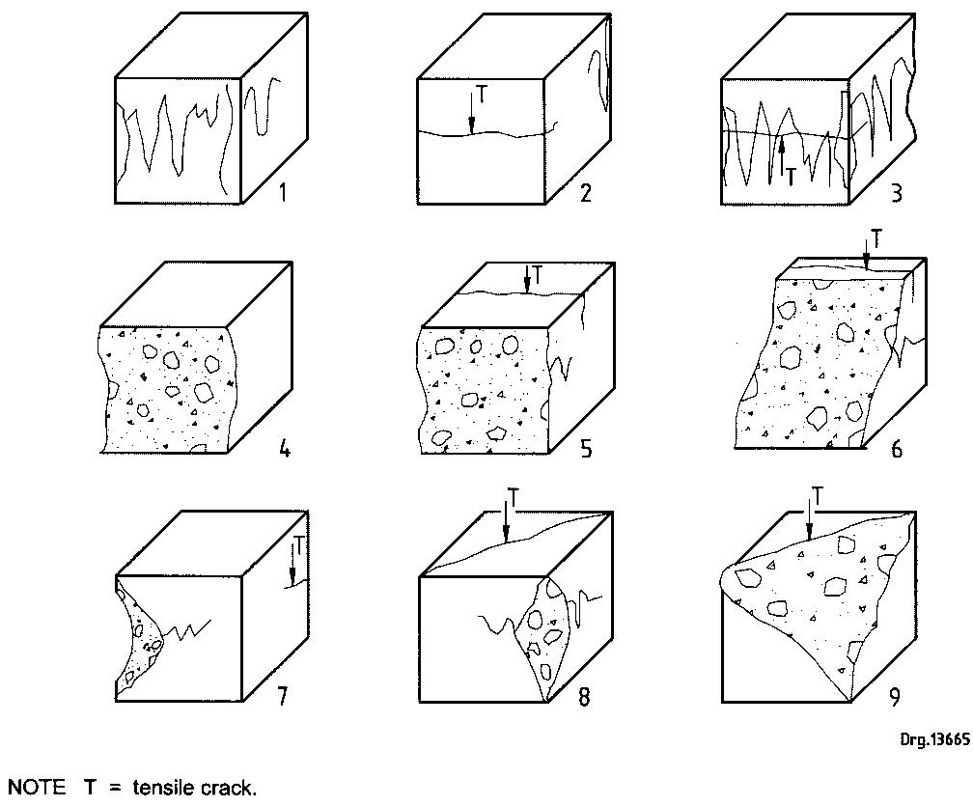
Unsatisfactory failures

Slide 38
TESTS ON HARD CONCRETE - CYLINDER TEST

Slide 39
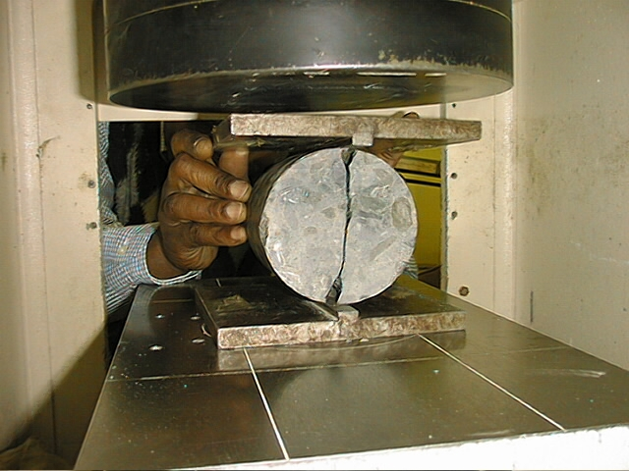

Slide 40
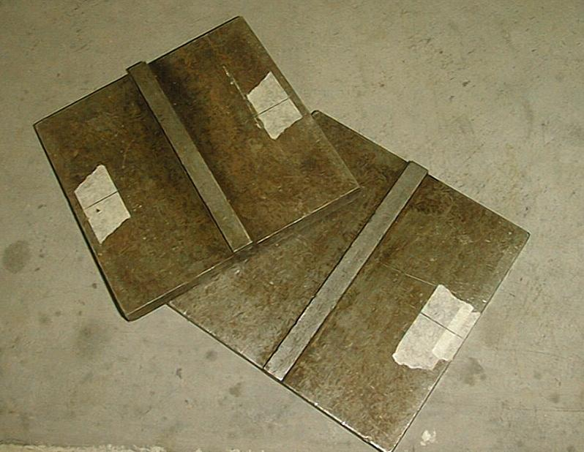
Splitting Test Platens

Slide 41
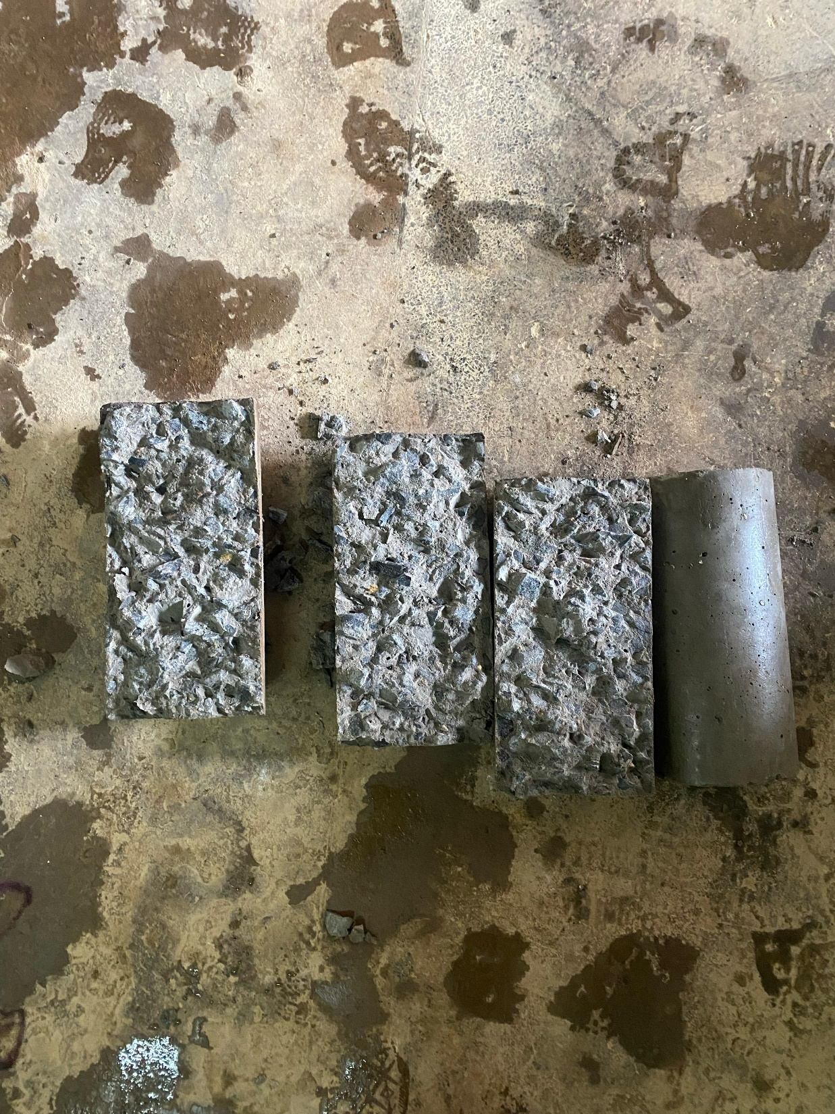
Tensile Strength
Not easy to measure directly
Indirect tests are:
  splitting test
  beam test (flexure)

Slide 42

Tensile splitting Test
On cylinders and cubes
BS EN 12390-6
Create tensile force through middle by compressive force
T = tensile strength (MPa)
P = failing load (N)
d = diameter of specimen (mm)
l = length of specimen (mm)
2P
T =
πld

Slide 43
TESTS ON HARD CONCRETE - BEAM TEST

Slide 44
Indirect tensile strength Test
Often called Modulus of Rupture
Prismatic beam of concrete supported on steel roller bearings near each end
Loaded from top
Can be single point or two-point (third-point) loading
Single gives higher values and is more variable
Beam size normally 150x150x750, also 100x100x500 if aggregate not greater than 20mm

Slide 45
Flexural Beam Test (BS EN 12390-5)
Third-point Loading
Center-point Loading
Head of Testing Machine
d=L/3
L/3
L/2
Span Length = L
Span Length = L

Slide 46
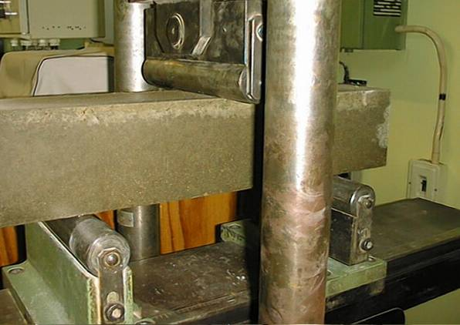
Center Point flexural strength test
Because the bending moment is highest directly under the centrally applied point load, the probability of failure here is greatest even though this part of the beam might not contain its weakest link. Therefore, this test can give overly optimistic results.

Slide 47
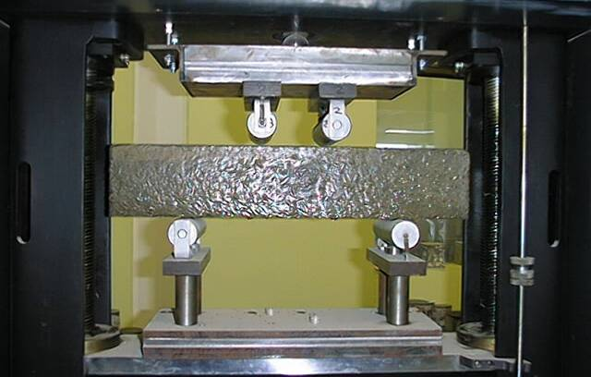
Two Point flexural strength test
Because the bending moment is constant between the top rollers, there is an equal probability of failure anywhere in the middle third of the span. Therefore, flexural failure is more likely to be governed by a weak link in this test and the results tend to be more conservative.

Slide 48
Flexural Beam Test
3Pl
2bd²
Pl
bd²
f =
f =
Center point
loading
Two point
loading
f = flexural strength (Mpa)
P = breaking load (N)
l = distance between supporting roller exes
b = width of specimen (mm)
d = depth of specimen (mm)

Slide 49
TESTS ON HARD CONCRETE – NON-DESTRUCTIVE TESTING (NDT)

Slide 50

Non-Destructive Testing and Inspection

Slide 51
NDT
Non-destructive tests permit testing hardened concrete in an actual structure
Non-destructive testing (NDT) methods for hardened concrete allow evaluation of its quality, integrity, and strength properties without causing permanent damage. These techniques are crucial for assessing concrete structures in place, detecting flaws such as voids and cracks and monitoring deterioration.
Types of NDT
    Rebound Hammer Test
    Ultra-sonic Pulse Velocity (UPV) Test
    Penetration Resistance Test
    Ground Penetrating Radar (GPR)
    Visual Inspection
    Pull-Out Test
    Radiographic Testing
    Coring Technique

Slide 52

Rebound Hammer Test
Principle: Measures the elastic rebound of a spring-loaded mass from the concrete surface, which correlates to the concrete's surface hardness and indirectly its strength.
Application: Quickly assesses concrete strength and surface hardness.
Tool: Schmidt hammer or rebound hammer.

Slide 53

Ultrasonic Pulse Velocity (UPV) Test
Principle: Measures the speed at which sound waves travel through the concrete, which is related to its internal quality and strength.
Application: Detects voids, delamination, and other defects within the concrete.
Standards: ASTM C597.

Slide 54

Penetration Resistance Test
Principle: Measures the resistance of concrete to penetration by a steel needle or probe.
Application: Provides a measure of concrete strength and hardness.
Tools: Windsor probe, spud pins.

Slide 55
Visual Inspection
Principle: Observing concrete for cracks, delamination, and other visible signs of deterioration.
Application: Provides an initial assessment of the concrete's condition.

Slide 56
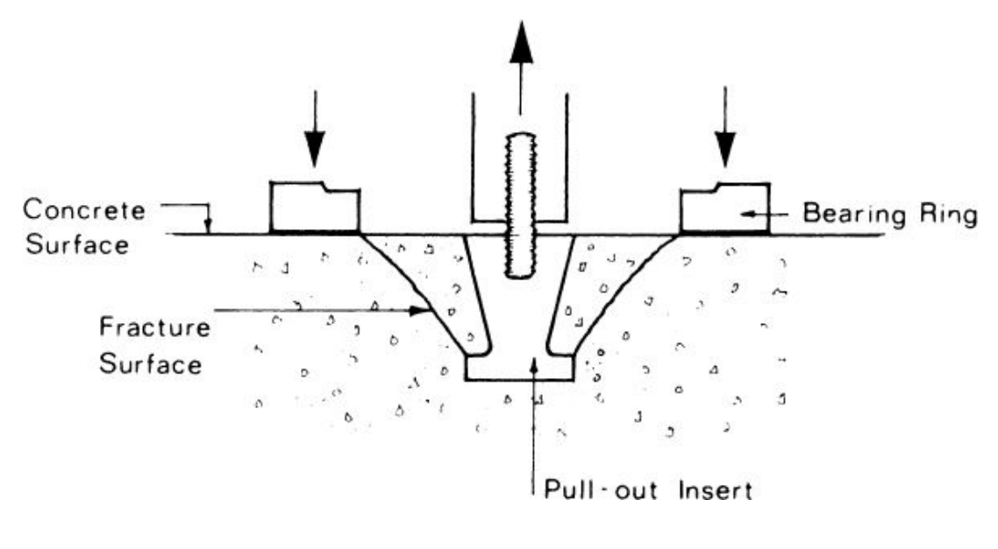
Pull-Out Test
Principle: Measures the force required to pull a steel rod pre-cast into the concrete, indicating the bond strength between concrete and reinforcement.
Application: Assesses the bond strength between concrete and reinforcement.

Slide 57

Radiographic Testing
Principle: Uses X-rays to detect internal defects like voids and the position of rebar.
Application: Provides a detailed view of the concrete's internal structure.

Slide 58
Core testing
When cubes fail, the best way to verify the strength of the in situ concrete is to drill cores and test their strength.
Cores are also ideal when;
    cubes get lost
    their results go missing
    there is a mix up with batch numbers
    when adding onto an existing structure
    when conducting a condition survey on structural health of an old structure
    Visual inspection of concrete

Slide 59
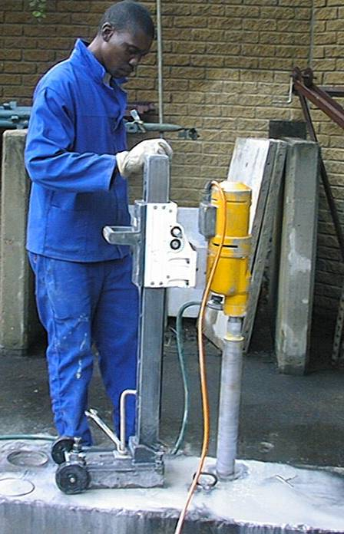
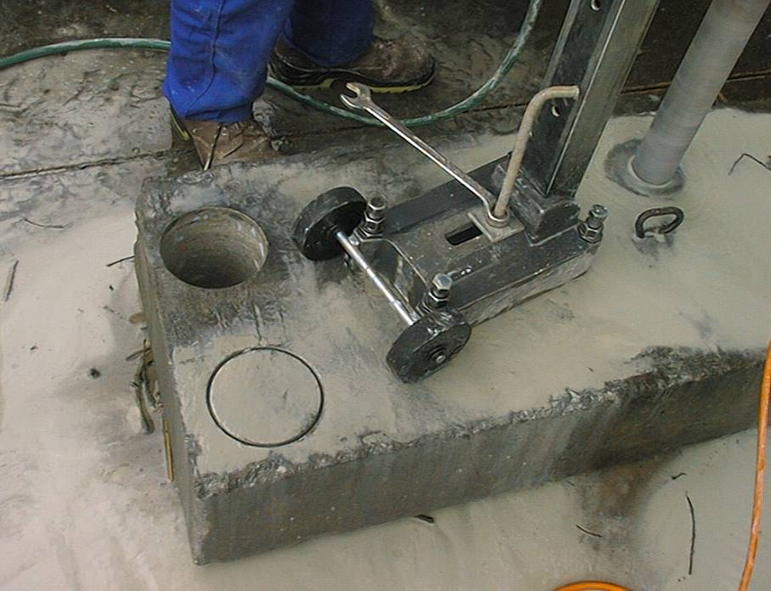
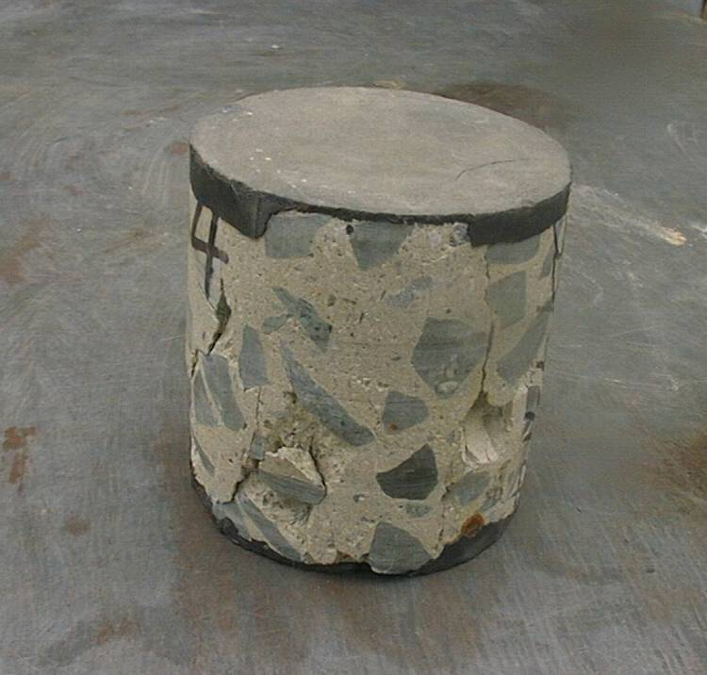
d
ℓ
The extraction and testing of cores is the best way to verify the strength of in situ concrete. As much of the cover concrete as possible is removed so that the final aspect ratio is one (ℓ/d = 1). The ends are capped or ground so they are square, parallel and plane.

Slide 60

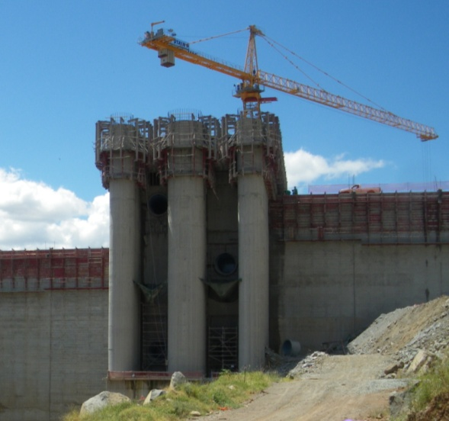
End

